Slide 1
EENG 284 Lab 05
Guessing Game With Hints
Notes:
Usually the <title of the lab> is what will be called the “System” through the rest of this document

Slide 2
Lab Objectives
Verilog
Using basic building blocks
Adder Subtractor
Simulation
Synthesis

Slide 3
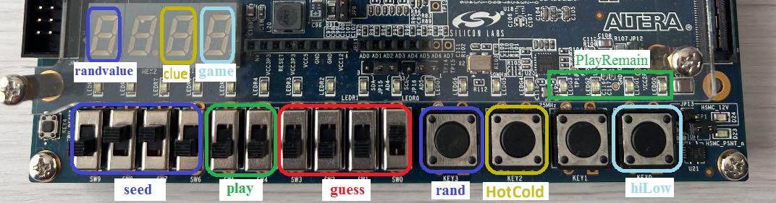
Game Play
Same game play as last week with a clue
The clue gives the “closeness” of the guess
Hot, warm or cold
Notes:
Replace <System> with the name of the

Slide 4
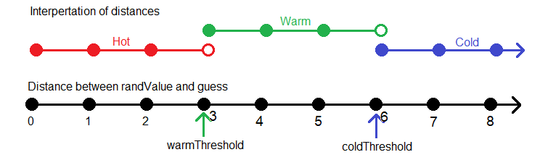
Game Play – The Clue Example
Guess that is within [0-2] is hot
Guess that is between [3-5] is warm
Guess that is 6 or more away is cold
Notes:
Replace <System> with the name of the

Slide 5
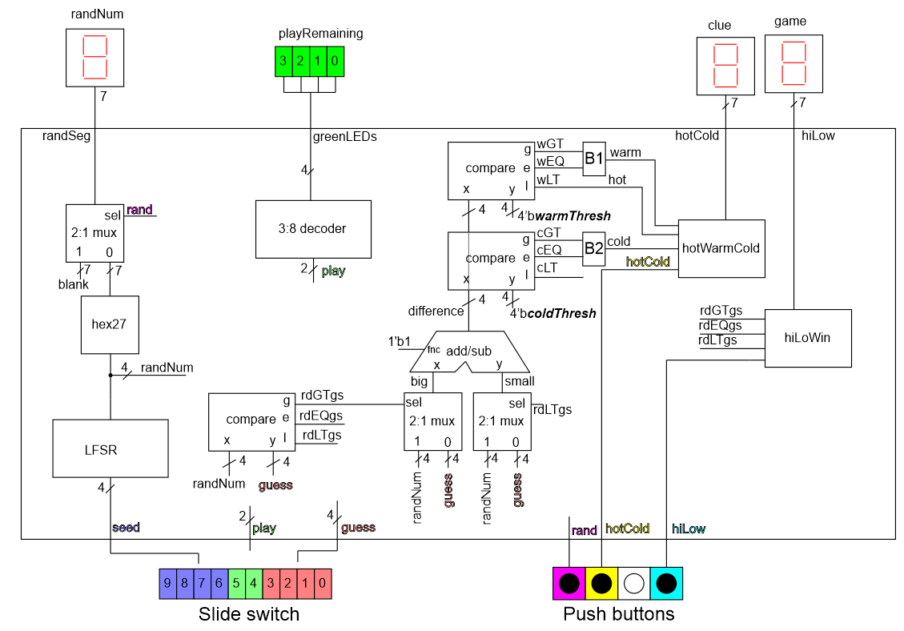
System Architecture
Notes:
Talk about the input is transformed into the output using the system architecture

Slide 6
Provided Code
Adder subtractor
Full adder
hotCold testbench

Slide 7
hiLow Module
Glue together
Module instantiations
2 2x1 muxes
2 comparators
1 adder subtractor (include fullAdder)
Always/case statements for hotWarmCold
Discrete logic to transform compare output to hot warm cold signal
Note high and low thresholds a re

Slide 8
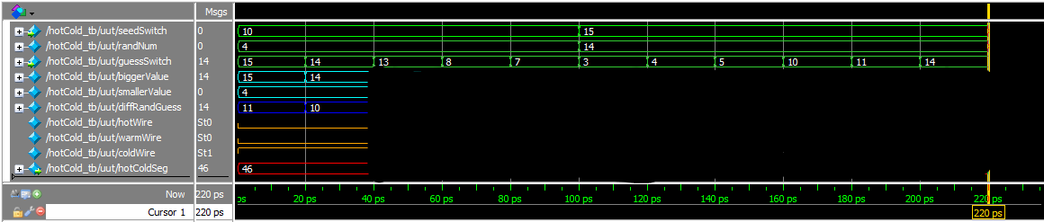
Deliverables
hiLow Testbench
Working hiLow implementation on Cyclone 5G boards

